Slide 1
Course Work – Fish Data Analysis
Data Quality check
df
400 rows × 3 columns
Drop Duplicate records based on time
df.drop_duplicates(subset=['time'], inplace=True)
356 rows × 3 columns

Slide 2
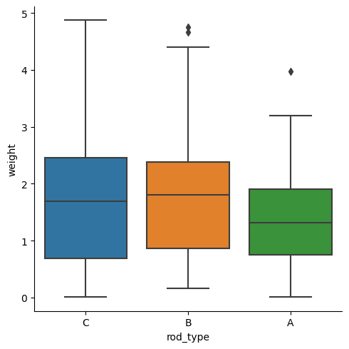
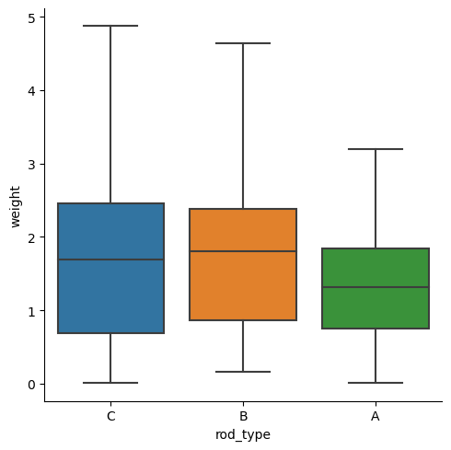
Data cleaning/preprocessing
Finding outliers
sns.catplot(data=df,x='rod_type',y='weight',kind='box’)
Removing Outliers
df.replace(to_replace=[3.97,4.88,4.50],value=3.625, inplace=True)
df.loc[156,'weight']=4.64(rod type= B)
df.loc[375,'weight']=4.64 (rod type= B)

Slide 3
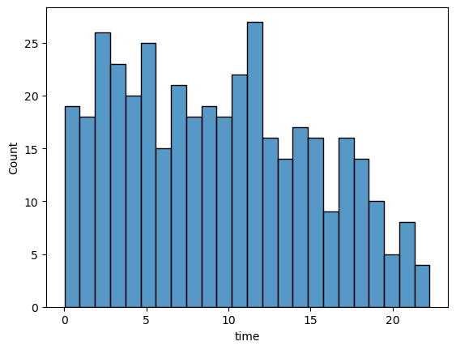
Generate a plot that illustrates the distributions of time values in hourly basis
sns.histplot(data=df,x= 'time' ,bins=24)

Slide 4
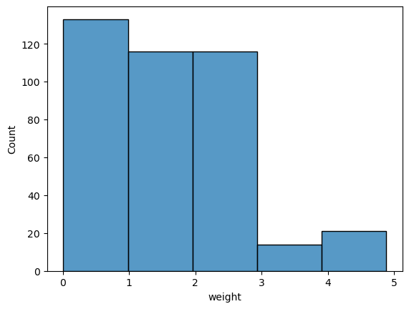
Generate a plot that illustrates the distributions of weight of fish values on weight basis
sns.histplot(data=df,x= 'weight' ,bins=5)

Slide 5
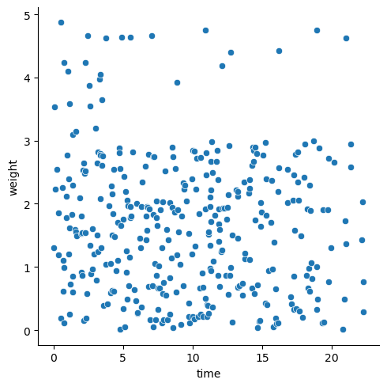
Illustrate the relationship between time(X) and weight(Y)
sns.relplot(data=df,x='time',y='weight’)

Slide 6
What is the correlation between X and Y? Analyse the amount of information about Y that is given by knowledge of X.
There is negative correlation time (X) and weight (Y), and it is inferred from df.corr()
 | time | weight
time | 1.000000 | -0.098087
weight | -0.098087 | 1.000000

Slide 7
What is the best time to go fishing at this lake?
The best time for fishing is between 12 AM to 4 AM (Early morning)
time = 0
while (time < 23) :
print(f" Average weight between time is {time} and {time+4} => {st.mean(df[(df['time’]>= time) & (df['time']<= (time+4)) ]['weight'])}")
time += 4
Output:
Average weight between time is 0 and 4 => 1.9985676691729324
Average weight between time is 4 and 8 => 1.5246984126984127
Average weight between time is 8 and 12 => 1.518641975308642
Average weight between time is 12 and 16 => 1.593934426229508
Average weight between time is 16 and 20 => 1.5693478260869564
Average weight between time is 20 and 24 => 1.7441666666666666

Slide 8
What is the best type of bait to use at 3pm in the afternoon?
Bait is B, because average weight of B is more than A & C,after 3PM

Slide 9
Which bait is most effective?
Bait B is effective, because average weight of B is more than A & C

